Slide 1
Notes from the Review and intro to discussion of next steps

Slide 2
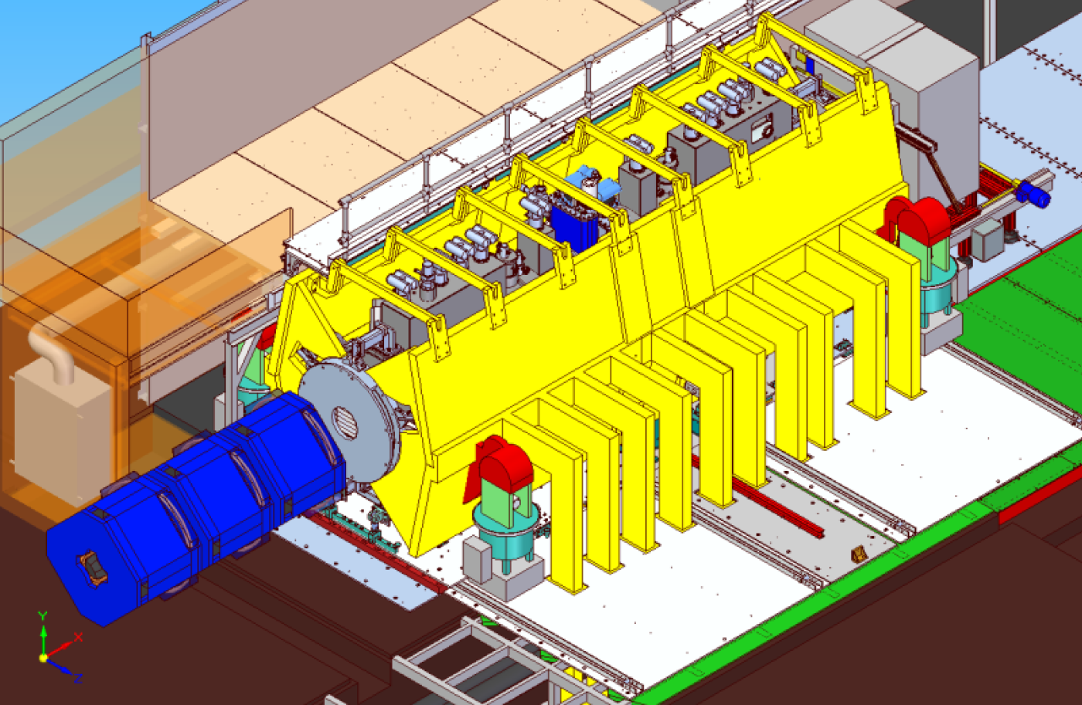

Slide 3
Close-out notes:
Good strategy.
Issues:
  Require to ensure implemented in such a way as to add no additional risk to the magnets;
    Consider instrumentation;
  Good to have south/north shielding being a reflection
    RAL should consider initiating this immediately since this is independent of the shielding per se;
  Time to access AFC a draw back.
    Suggest project revisit this;
  PRR review required, should happen before major procurement.
    At the PRR, should have basic concept for what is required for Step VI to ensure that are not creating substantial additional work at Step VI;
Schedule:
  Float in schedule not generous and must approach it with energy; i.e. need to initiate work quickly;
  In this regard agree that its important that Steve Plate visits to make sure that interface issues are addressed between Plate and Tarrant;
Process required whereby RAL signs off on the drawings;
  Step VI
    Consider dismantling at least south-side shielding wall;
Simulation work:
  Beneficial to use Step IV configuration to bench mark simulations to aid development of Step VI shielding;
  Commissioning strategy; what is the strategy for commissioning involving the collaboration etc. Need clear responsibility definitions;
Additional comment from ISIS:
  PRY removes ISIS issues

Slide 4
My take:
From Jun12 to Aug13:
  60—70% modeling; 40—30% engineering;
Now moving to:
  Engineering supported by modeling;
Outstanding issues:
  Modelling:
    Stray field outside yoke when PRY implemented in Hall model;
      Need to check for “gotchas”;
        Low risk, I think;
      Need to check particular areas, including:
        LH2 gas panel;
        Roof;
        Linde refrigerator
      Need to see if we can simplify Hall:
        E.g. can we remove the south-side magnetic-shielding floor plates of some of the South Wall Panels to assist with penetrations
  Integration with experiment’s magnets:
    Size and effect of horizontal, transverse forces;
      Will lead to a specification on the alignment tolerances;
    Does the PRY have a deleterious effect on magnet training;
      Reaction between PRY and coils has the potential to increase with current
    Analysis of quenches;
      Review of quench calculations in presence of PRY;
  Engineering:
    Interfaces and definition of scope of supply (UK/US);
    Concept for Steps V and VI

Slide 5
Intro to discussion:
Discuss now, and between now and next meeting:
  How best can we organise the PRY project such that:
    PRY can be ready ~Mar15 when ISIS comes back online after long shutdown;
    A fit-up and shake-down without magnetic field can take place before the long shutdown
DONM:
  15Oct13; 15:00 BST

